Slide 1
Strategic Rereading
Don’t Give Up!!

Slide 2
The man couldn’t wear the t-shirt because he was preggilated.
Why couldn’t the man wear the t-shirt?
What couldn’t the man wear?
Explain why the man couldn’t wear the t-shirt.
It depends on what
they need to know!
s
Notes:
It depends what they need to know.

Slide 3
Teach kids to figure out which words they need to know. We don’t necessarily need to know them all!
The country is India. A buprious official and his wife are giving a large dinner party. They are seated with their guests—army officers and government corbators and their wives, and a visiting American estubol—in their spacious dining room, which has a bare marble floor, open rafters, and wide glass doors opening onto a sturbolator.
Who: Official and his wife, What: Throwing a dinner party, Where: India (living room), When: Evening
s
Notes:
6:10

Slide 4
The country is India. A colonial official and his wife are giving a large dinner party. They are seated with their guests—army officers and government attachés and their wives, and a visiting American naturalist—in their spacious dining room, which has a bare marble floor, open rafters, and wide glass doors opening onto a veranda.
  The Dinner Party, by Mona Gardner
s

Slide 5
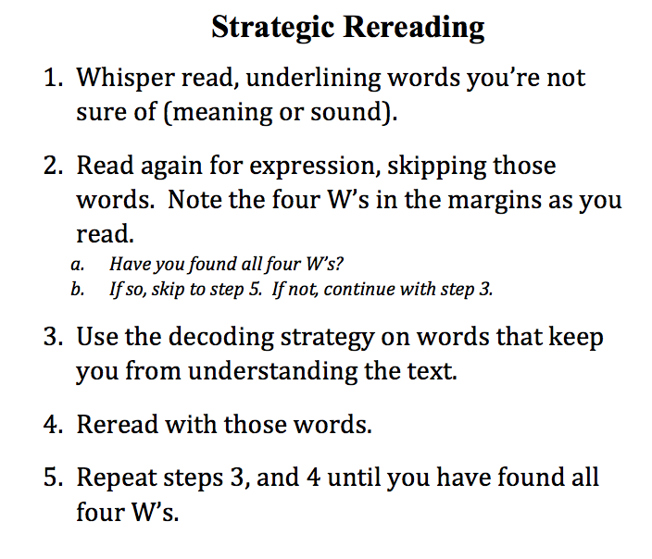
*
*Don’t understand the word meaning? Look it up on Google Images.

