Slide 1

Week 4
Theme Vocabulary
Step 1. Selecting the Words secretive superior class

Slide 2
Step 2. Introduce the Word
THEME WORD ONE: secretive

Slide 3
secretive
secret
secretly
secretive smile
highly secretive
family secret
keep a secret
Can you think of any other words with the suffix –ive?

Slide 4
Step 3. Rate Your Word Knowledge

Slide 5
Rate your Knowledge
1- I don’t know it.
2- I’ve heard it, but I don’t know the meaning.
3- I can use it in a sentence.
4- I can teach it to the class.

Slide 6
Step 4. Explanation and Example

Slide 7
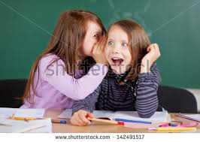
secretive
If you are secretive, you like to have secrets and to keep your thoughts, feelings, or actions hidden from others.
Example from The Stolen Party
“Luciana put on a secretive look and whispered into Rosaura's ear, ‘He's in the kitchen. But don't tell anyone, because it's a surprise!’”

Slide 8
Step 5. Interact with the Word

Slide 9
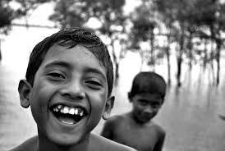
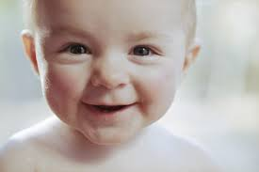
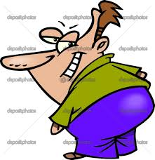
A: Who has a secretive smile?
B: I think _________ has a secretive smile because ________________.

Slide 10

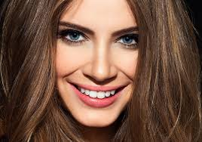
B: Who does not have a secretive smile?
A: I think _________ does not have a secretive smile because ________________.

Slide 11
A: What would make you be highly secretive?
Your best friend told you he had a crush on a girl.
You accidentally took a pencil off of your friend’s desk.
B: I would be highly secretive if I __________________ because _____________.

Slide 12
B: What would make you be highly secretive?
You borrowed your sister’s shirt without asking.
You had a party while your parents were out of town.
A: I would be highly secretive if I __________________ because _____________.

Slide 13
Step 6. Review, Review, Review

Slide 14
Come up with an example of when you might want to be secretive:
Example: I would be secretive if I heard a rumor about a friend, and I didn’t want them to find out.
3 minutes until you share. Extra time? Add an illustration from google images. Extra Extra Time? Practice saying your sentence:
I would be secretive if I____________________.
Notes:
This is optional. If you are having students write the words and definitions in a DVT- then I would recomment having them connect it to the story as a review activity.

Slide 15
Step 2. Introduce the Word
THEME WORD TWO: superior

Slide 16
superior
superior skill
superior product
clearly superior
far superior
Can you think of any other words with the suffix –or?

Slide 17
Step 3. Rate Your Word Knowledge

Slide 18
Rate your Knowledge
1- I don’t know it.
2- I’ve heard it, but I don’t know the meaning.
3- I can use it in a sentence.
4- I can teach it to the class.

Slide 19
Step 4. Explanation and Example

Slide 20
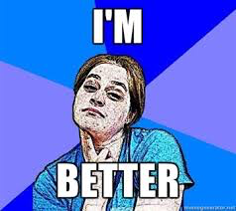
superior
If something or someone is superior it is better than something else.
Example from “The Stolen Party”
“The mother swung around and pompously* put her hands on her hips.”
*You do something pompously if you think you are superior.

Slide 21
Step 5. Interact with the Word

Slide 22
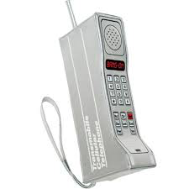
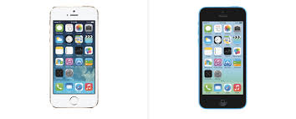
Which product is far superior?
________ is clearly superior because _______________________________.
Notes:
In The Stolen Party people think they are superior or better.

Slide 23


Which restaurant is far superior?
________ is clearly superior because _______________________________.
Notes:
In The Stolen Party people think they are superior or better.

Slide 24
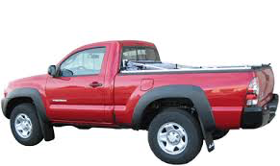
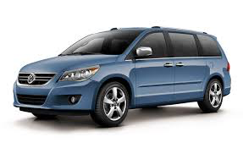
Which vehicle is superior?
________ is clearly superior because _______________________________.
Notes:
In The Stolen Party people think they are superior or better.

Slide 25


Which console is superior?
________ is clearly superior because _______________________________.
Notes:
In The Stolen Party people think they are superior or better.

Slide 26
Who has superior skill?
Beyoncé
OR
Rihanna
________ has superior skill my evidence is ______________________.
Notes:
In The Stolen Party people think they are superior or better.

Slide 27
Step 6. Review, Review, Review

Slide 28
Come up with an example of a time when you felt superior OR when you were around someone who felt superior:
Example: My friend thought he was superior at tennis, but he challenged me to a game, and I won!
3 minutes until you share. Extra time? Add an illustration from google images. Extra Extra Time? Practice saying your sentence:
I felt superior when____________________.
__________thought he/she was superior when___________________.
Notes:
This is optional. If you are having students write the words and definitions in a DVT- then I would recomment having them connect it to the story as a review activity.

Slide 29
Step 2. Introduce the Word
THEME WORD THREE: class

Slide 30
class
lower class
middle class
upper class
high class

Slide 31
Step 3. Rate Your Word Knowledge

Slide 32
Rate your Knowledge
1- I don’t know it.
2- I’ve heard it, but I don’t know the meaning.
3- I can use it in a sentence.
4- I can teach it to the class.

Slide 33
Step 4. Explanation and Example

Slide 34
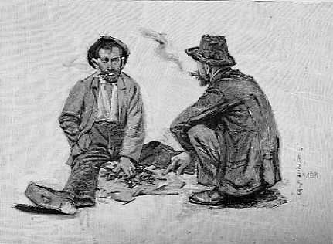
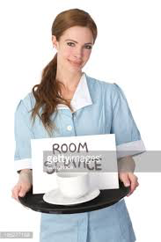
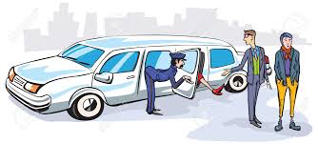
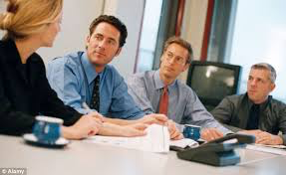
class
Class is how people in a society are divided into groups based on their jobs, income, education.
Example:
lower class | working class | middle class | upper class

Slide 35
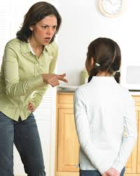
Example from “The Stolen Party”
Rosaura’s mom thinks Luciana is _______________ class. She says, “It is a rich people’s party.”

Slide 36
Step 5. Interact with the Word

Slide 37
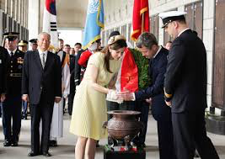
Which class do you think these people are labeled with?
They are _________________ class because_______________________________.

Slide 38
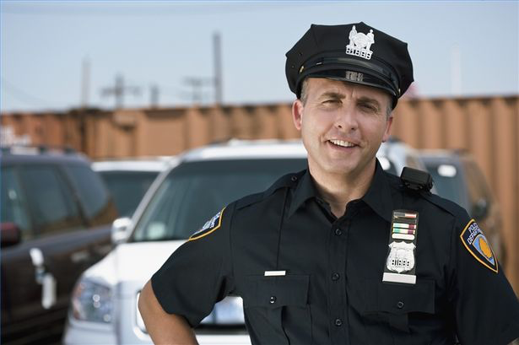
Which class do you think these people are labeled with?
They are _________________ class because_______________________________.

Slide 39
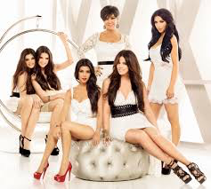
Which class do you think these people are labeled with?
They are _________________ class because_______________________________.

Slide 40
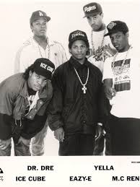
Which class do you think these people are labeled with?
Before they were famous:
They are _________________ class because_______________________________.

Slide 41
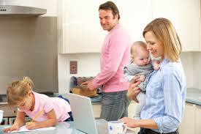
Which class do you think these people are labeled with?
They are _________________ class because_______________________________.

Slide 42
Step 6. Review, Review, Review

