Slide 1

Morphology Instruction
duct/duce/duc
Notes:
Have students open their flash drives.
These slides would be taught over a number of days. They will probably take multiple weeks for students to complete since this is their first exposure to these concepts.

Slide 2
What is a root?
autobiography
project
Notes:
Review options: give students 1 minute and have them write down as many words with graph as they can, or ask someone to lead you through LINCS with graph (on next slide), and then go around the room asking each person to give one word that contains this root.

Slide 3
Review with LINCS
What is the story?
What is the reminding word?
What is the word?
What is the definition?

Slide 4
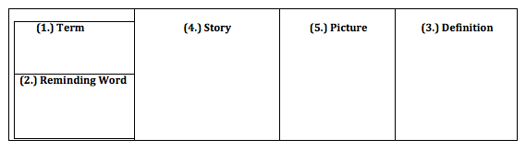
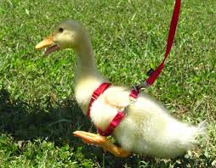
LINCS
duct
I lead the duck around like it is my pet.
To lead
duck

Slide 5
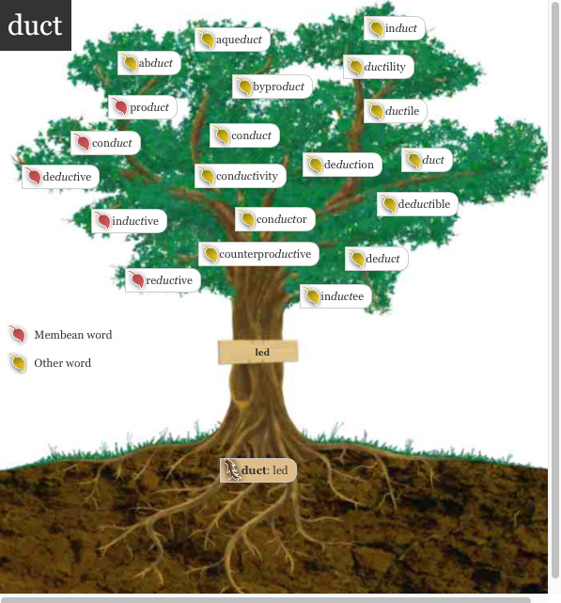
Notes:
A preview of all the words students will have a better understanding of if they learn “ject”

Slide 6
The burglars broke into the house and abducted the dog.
Do you recognize the root? (whiteboard)
Try out the meaning of the root in the sentence.
What do you think the word means?
Notes:
Have ½ the class do sentence number 1 and ½ the class do sentence number 2.

Slide 7
Add it to your personal dictionary
word | prefix | suffix | root | definition | sample
abducted
ab
ed
to lead
away
duct
by force
Notes:
Students make an inference about the definition. Teacher/aide monitor and correct as needed. Have the students come up with the answers before answers appear. Have a brief conversation about how literal meaning “to lead away” doesn’t capture the essence (connotation) of the word.

Slide 8
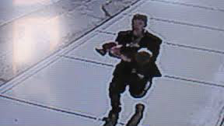
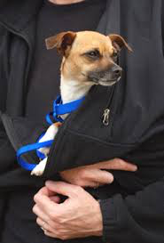

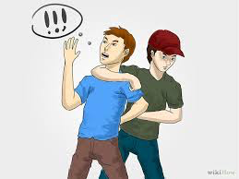
________ is abducting _________.

Slide 9
1. Dennis had recently begun a successful career conducting opera in Europe.
2. He conducted a science experiment
3. On my report card I received an ”E” for excellent conduct.
Do you recognize the root? (whiteboard)
Try out the meaning of the root in the sentence.
What do you think the word means?

Slide 10
Add it to your personal dictionary
word | prefix | suffix | root | definition | sample
Three definitions
before next slide
write down one!
conduct
con
duct
Notes:
Students make an inference about the definition. Teacher/aide monitor and correct as needed. Have the students come up with the answers before answers appear.

Slide 11



Conduct
1. To lead a group.
2. To lead an activity.
3. To lead, or manage yourself in
a certain way.

Slide 12
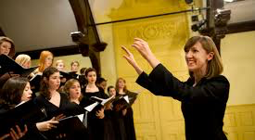

She is conducting_____________.

Slide 13


How would you describe his conduct?

Slide 14
Someone introduced us, and I sat next to him.
Do you recognize the root? (whiteboard)
Try out the meaning of the root in the sentence.
What do you think the word means?

Slide 15
Add it to your personal dictionary
word | prefix | suffix | root | definition | sample
To lead a
person into
A place or
group
introduce
intro
duc
Notes:
Students make an inference about the definition. Teacher/aide monitor and correct as needed. Have the students come up with the answers before answers appear. Note: You want them to try and create a fairly literal definition with root word and prefix.

Slide 16
It can be considered rude to suddenly interject a question into a conversation that doesn't involve you.
Do you recognize the root? (whiteboard)
Try out the meaning of the root in the sentence.
What do you think the word means?

Slide 17
Introducing yourself formally:
A: “I’d like you to meet my friend ________.”
B: “Hello, my name is ___________.”
C: “It’s nice to meet you ____________.”
Notes:
Assign students A, B, & C have them practice introducing themselves formally

Slide 18
Introducing yourself formally
C: “I’d like you to meet my colleague ______.”
A: “Hello, my name is ____________.”
B: “Pleased to meet you ____________.”
Notes:
Assign students A, B, & C have them practice introducing themselves formally

Slide 19
The company deducted this payment from his paycheck.
Do you recognize the root? (whiteboard)
Try out the meaning of the root in the sentence.
What do you think the word means?

Slide 20
Add it to your personal dictionary
word | prefix | suffix | root | definition | sample
To lead away from
deduct
de
duct
Notes:
Students make an inference about the definition. Teacher/aide monitor and correct as needed. Have the students come up with the answers before answers appear. Note: You want them to try and create a fairly literal definition with root word and prefix.

Slide 21
Let’s do some white board math!
Deduct 5 from 7.
Deduct 10 from 12.
Deduct ½ of 10.
Deduct 4 from 9.
Deduct 10 from 15.

Slide 22
Exercise reduces the risks of
heart disease.
Do you recognize the root? (whiteboard)
Try out the meaning of the root in the sentence.
What do you think the word means?

Slide 23
Add it to your personal dictionary
word | prefix | suffix | root | definition | sample
To lead back from something; to make
smaller
reduce
re
duce
Notes:
Students make an inference about the definition. Teacher/aide monitor and correct as needed. Have the students come up with the answers before answers appear. Note: You want them to try and create a fairly literal definition with root word and prefix.

Slide 24
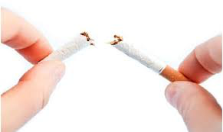
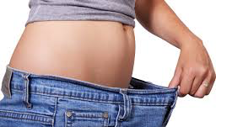

She is reducing _____________.

Slide 25
Drinkwise Day is mainly designed to educate people about the destructive effects of alcohol abuse.
Do you recognize the root? (whiteboard)
Try out the meaning of the root in the sentence.
What do you think the word means?

Slide 26
Add it to your personal dictionary
word | prefix | suffix | root | definition | sample
to lead to knowledge
educate
e
ate
duc
Notes:
Students make an inference about the definition. Teacher/aide monitor and correct as needed. Have the students come up with the answers before answers appear. Note: You want them to try and create a fairly literal definition with root word and prefix.

Slide 27
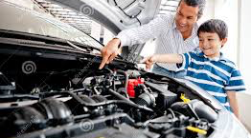
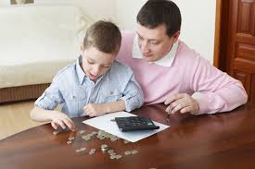

He is educating ____ about _______.

