Slide 1

Week 1
Theme Vocabulary
Step 1. Selecting the Words conflict crisis reason

Slide 2
Step 2. Introduce the Word
THEME WORD ONE: conflict

Slide 3
conflict
I am conflicted.
The two ideas are conflicting.
internal conflict
external conflict
family conflict
avoid conflict
deal with conflict

Slide 4
Step 3. Rate Your Word Knowledge

Slide 5
Rate your Knowledge
1- I don’t know it.
2- I’ve heard it, but I don’t know the meaning.
3- I can use it in a sentence.
4- I can teach it to the class.

Slide 6
Step 4. Explanation and Example

Slide 7
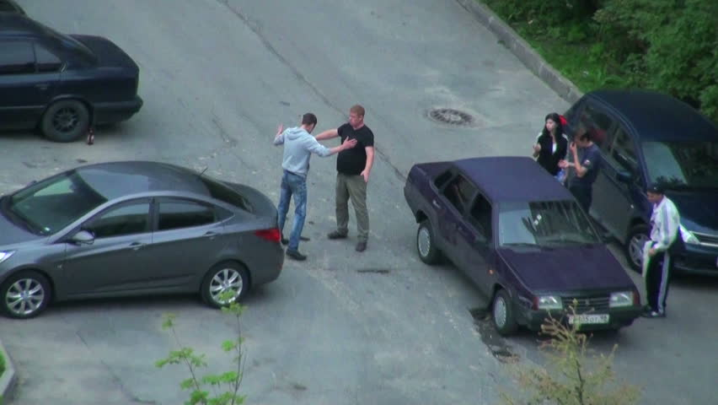
conflict
A conflict is a type of fight or disagreement; an argument between people, groups or countries.
Example:
If two people are in a car accident, and they can’t agree on what happened, they might be in a conflict.

Slide 8
Step 5. Interact with the Word

Slide 9
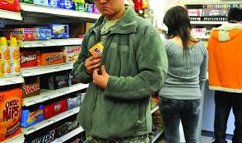
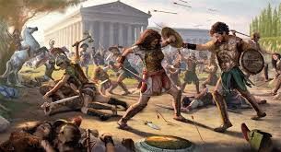
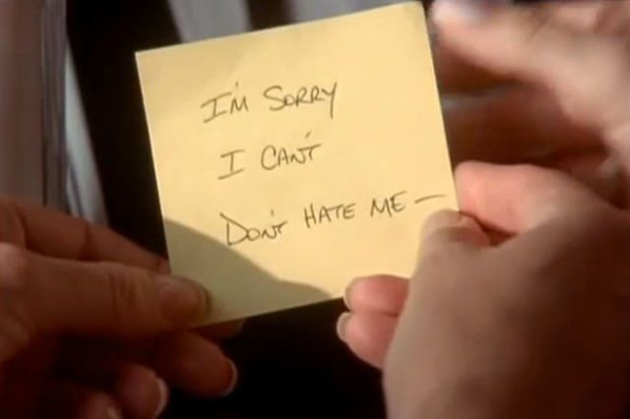
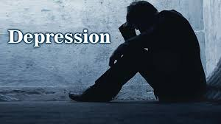

Internal Conflict OR External Conflict
I think that is an___________conflict because ________________.
Notes:
Students Should write down both of the terms on their white boards. Use the pictures to have a discussion about the meanings. When you display a picture (on the click) have them put a check mark by the one they think the conflict is. They should then put it in a sentence frame (orally). They can share with each other or with the class.

Slide 10

A: When was the last time you were in a conflict? What was it?
B: The last time I was in a conflict was when___________________________.
Notes:
Ask students to work in pairs to find the answer to this question. They should respond and then switch roles. TELL STUDENTS TO ONLY SHARE WHAT THEY ARE COMFORTABLE SHARING. Afterwards they can put their sample sentence in their personal dictionary.

Slide 11
Step 6. Review, Review, Review

Slide 12
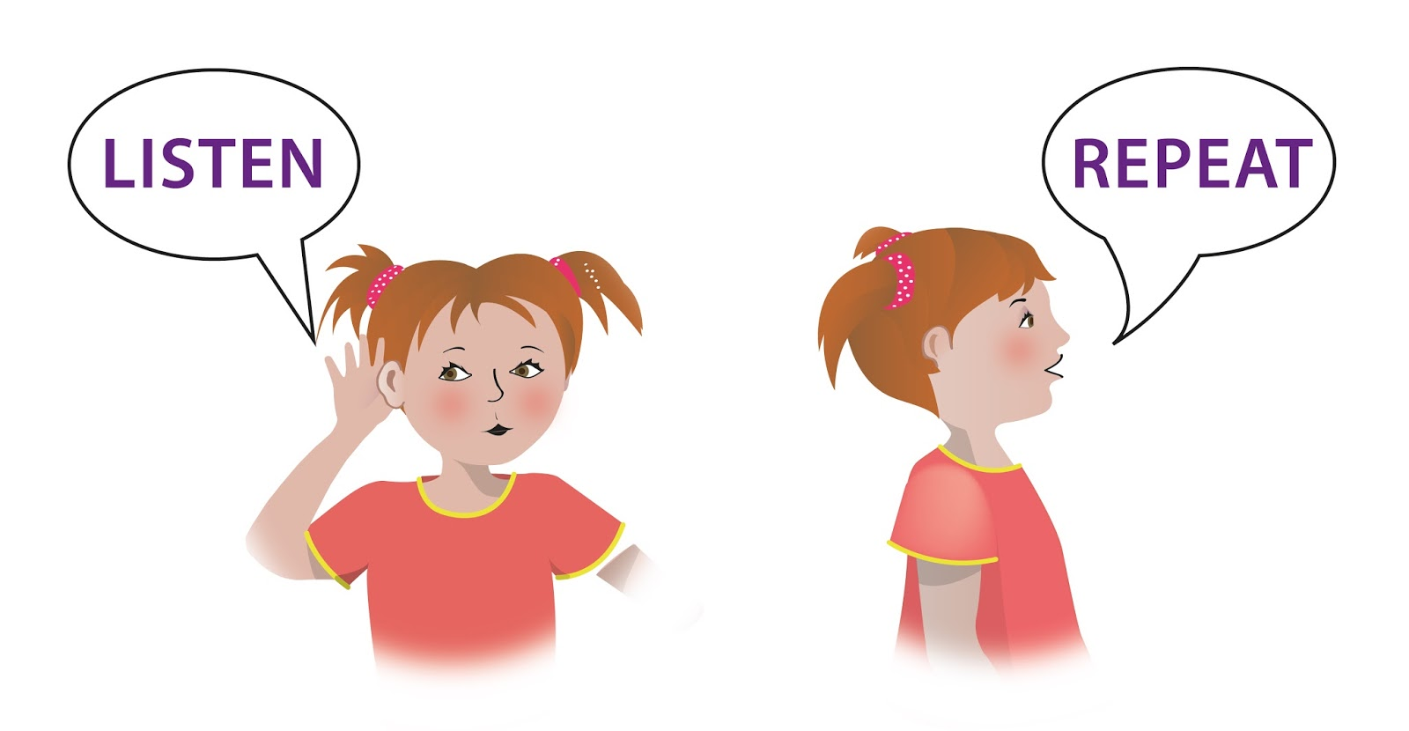
Raise your hand if you can share your sentence from the word conflict.
Listen to what your classmate says.
Repeat their sentence.
Share your own!
Notes:
Start of the next day’s lesson like this, OR if you still have time on the same day.

Slide 13
Step 2. Introduce the Word
THEME WORD TWO: crisis

Slide 14
crisis
major crisis
health crisis
face a crisis
deal with a crisis
avoid a crisis
Notes:
Have students say phrases out loud.

Slide 15
Step 3. Rate Your Word Knowledge

Slide 16
Rate your Knowledge
1- I don’t know it.
2- I’ve heard it, but I don’t know the meaning.
3- I can use it in a sentence.
4- I can teach it to the class.

Slide 17
Step 4. Explanation and Example

Slide 18
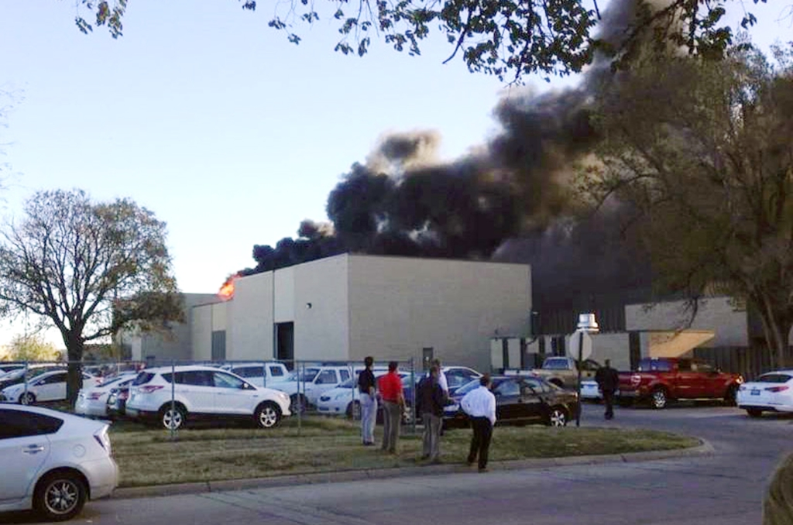
crisis
A situation in which there are a lot of problems that must be dealt with quickly so that the situation does not get worse or more dangerous. An emergency situation.
Example: If there was a fire in an office building that would be a crisis.
What are the problems that would have to be dealt with immediately, so it didn’t get more dangerous?
Notes:
Students choral read. Put explanation in their personal dictionary. Have a class discussion about the word.

Slide 19
Step 5. Interact with the Word

Slide 20

Crisis or Peace?
Notes:
Have students write crisis or peace on their whiteboards. If they hold up a whiteboard that means they are ready to explain their answer.

Slide 21
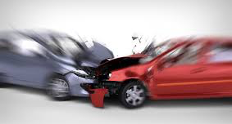
Crisis or Peace?

Slide 22

Crisis or Peace?

Slide 23
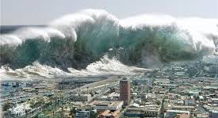
Crisis or Peace?

Slide 24
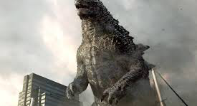
Crisis or Peace?

Slide 25

Crisis or Peace?

Slide 26
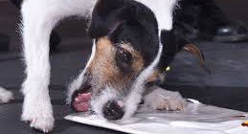
Crisis or Peace?

Slide 27

Crisis or Peace?

Slide 28
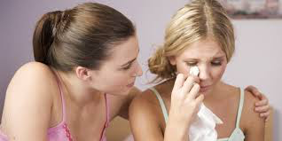
Crisis or Peace?

Slide 29
Step 6. Review, Review, Review

Slide 30

1. Do you think there is going to be a crisis in the most dangerous game?
If no, why not?
If yes, what do you think it could be?
Notes:
This is optional. If you are having students write the words and definitions in a DVT- then I would recomment having them connect it to the story as a review activity.

Slide 31
Step 2. Introduce the Word
THEME WORD THREE: reason

Slide 32
Reason
ability to reason
try and reason
listen to reason
appeal to reason

Slide 33
Step 3. Rate Your Word Knowledge

Slide 34
Rate your Knowledge
1- I don’t know it.
2- I’ve heard it, but I don’t know the meaning.
3- I can use it in a sentence.
4- I can teach it to the class.

Slide 35
Step 4. Explanation and Example

Slide 36

Definition
To reason is the the ability to think.
Means the same:
to have brains
To be logical
To be intelligent

Slide 37

Example
General Zaroff does not think hunting animals is exciting because they can’t reason, or think.

Slide 38
Step 5. Interact with the Word

Slide 39
Activity
Practice saying each sentence 3 times quickly:
“You must be able to reason to do that. Because___________________.”
OR
“You do not have to be able to reason to do that because ___________________.”

Slide 40
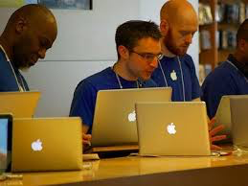
“You must be able to reason to do that because______________.”
OR
“You do not have to be able to reason to do that because_________________.”

Slide 41

“You must be able to reason to do that because ____________.”
OR
“You do not have to be able to reason to do that because_____________.”

Slide 42
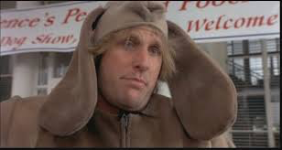
“You must be able to reason to do that because _______________.”
OR
“You do not have to be able to reason to do that because ______________________.”

Slide 43
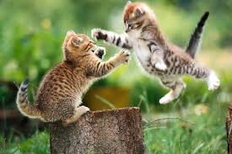
“You must be able to reason to do that because ___________________.”
OR
“You do not have to be able to reason to do that because __________________.”

Slide 44
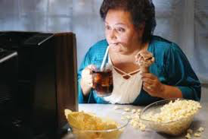
“You must have be able to reason to do that because _________________.”
OR
“You do not have to be able to reason to do that because ____________________.”

Slide 45
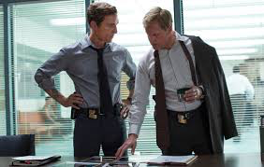
“You must be able to reason to do that because _________________________.”
OR
“You do not have to be able to reason to do that because _____________________________.”

Slide 46
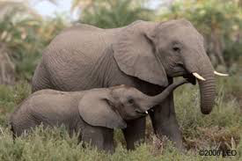
“You must be able to reason to do that because ______________________.”
OR
“You do not have to be able to reason to do that because _________________________.”

Slide 47
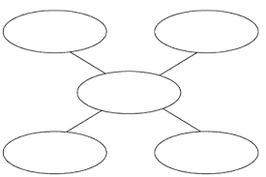
Create Your Web with the following categories:
Jobs that require reason
What things don’t require reason
Words that mean the same as reason
Words that mean the opposite of reason
reason

Slide 48
Step 6. Review, Review, Review

Slide 49
75 Points
Internal conflict
75 Points
External conflict
50 Points
reason
50 Points
crisis
20 Points
The principal
20 Points
Selena Gomez
20 Points
Beyoncé
Notes:
You may call up students individually and have them put their back to the board, but for more participation have them work in pairs. One person turns their back to the board and the other person gives them clues, examples, non-examples, cloze sentences, etc. Anthing to get them to guess the word, except letters that are in the word.

