Slide 1

Morphology Instruction
ject
Notes:
Have students open their flash drives.
These slides would be taught over a number of days. They will probably take multiple weeks for students to complete since this is their first exposure to these concepts.

Slide 2
What is a root?
autograph
Notes:
Review options: give students 1 minute and have them write down as many words with graph as they can, or ask someone to lead you through LINCS with graph (on next slide), and then go around the room asking each person to give one word that contains this root.

Slide 3
Review with LINCS
What is the story?
What is the reminding word?
What is the word?
What is the definition?

Slide 4
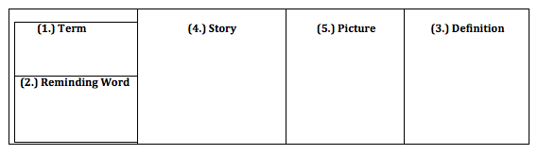
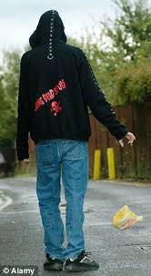
LINCS
Don’t be a jerk- throw your trash in the garbage!
ject
throw
jerk

Slide 5
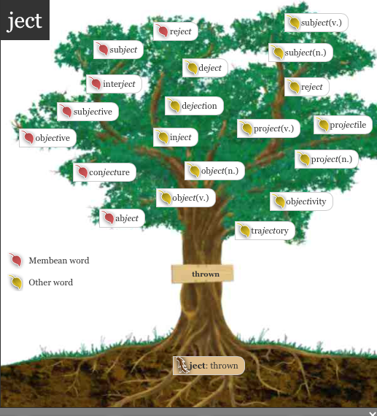
Notes:
A preview of all the words students will have a better understanding of if they learn “ject”

Slide 6
1. The vending machine rejected my dollar because it was torn.
2. Romantic rejection can be painful and embarrassing.
Do you recognize the root? (whiteboard)
Try out the meaning of the root in the sentence.
What do you think the word means?
Notes:
Have ½ the class do sentence number 1 and ½ the class do sentence number 2.

Slide 7
Add it to your personal dictionary
word | prefix | suffix | root | definition | sample
to throw
back
reject
re
ject
Notes:
Students make an inference about the definition. Teacher/aide monitor and correct as needed. Have the students come up with the answers before answers appear.

Slide 8
1. The drug is injected directly into the base of the spine.
2. Traditional handbag makers are injecting more fun into their designs.
Do you recognize the root? (whiteboard)
Try out the meaning of the root in the sentence.
What do you think the word means?

Slide 9
Add it to your personal dictionary
word | prefix | suffix | root | definition | sample
to throw
into
inject
in
ject
Notes:
Students make an inference about the definition. Teacher/aide monitor and correct as needed. Have the students come up with the answers before answers appear. Note: You want them to try and create a fairly literal definition with root word and prefix.

Slide 10
1. Four hundred workers have been ejected from their jobs with no warning.
2. If you eject a tape or disk, or if it ejects, it comes out of a machine after you have pressed a particular button.
Do you recognize the root? (whiteboard)
Try out the meaning of the root in the sentence.
What do you think the word means?

Slide 11
Add it to your personal dictionary
word | prefix | suffix | root | definition | sample
to throw
out
eject
e
ject
Notes:
Students make an inference about the definition. Teacher/aide monitor and correct as needed. Have the students come up with the answers before answers appear. Note: You want them to try and create a fairly literal definition with root word and prefix.

Slide 12
It can be considered rude to suddenly interject a question into a conversation that doesn't involve you.
Do you recognize the root? (whiteboard)
Try out the meaning of the root in the sentence.
What do you think the word means?

Slide 13
Add it to your personal dictionary
word | prefix | suffix | root | definition | sample
to throw
something
In between
interject
inter
ject
Notes:
Students make an inference about the definition. Teacher/aide monitor and correct as needed. Have the students come up with the answers before answers appear. Note: You want them to try and create a fairly literal definition with root word and prefix.

Slide 14
1. He just hasn't been able to project himself as the strong leader.
2. I am projecting this power point onto the smartboard.
3. He projects his own thoughts and ideas onto her.
Do you recognize the root? (whiteboard)
Try out the meaning of the root in the sentence.
What do you think the word means?

Slide 15
Add it to your personal dictionary
word | prefix | suffix | root | definition | sample
to throw
forward or outward
project
pro
ject
Notes:
Students make an inference about the definition. Teacher/aide monitor and correct as needed. Have the students come up with the answers before answers appear. Note: You want them to try and create a fairly literal definition with root word and prefix.

Slide 16
1. The king subjected the traitor to torture even though he tried to get away.
2. Rosaura may be subjected to teasing at the party.
3. I don’t want to subject you to a boring lecture, but I may have to.
Do you recognize the root? (whiteboard)
Try out the meaning of the root in the sentence.
What do you think the word means?

Slide 17
Add it to your personal dictionary
word | prefix | suffix | root | definition | sample
to throw
Someone under
something or someone
subject
sub
ject
Notes:
Students make an inference about the definition. Teacher/aide monitor and correct as needed. Have the students come up with the answers before answers appear. Note: You want them to try and create a fairly literal definition with root word and prefix.

Slide 18
My parents objected to my outfit, so I had to change.
2. I am starting a protest because I object to the amount of homework my teacher gives us.
Do you recognize the root? (whiteboard)
Try out the meaning of the root in the sentence.
What do you think the word means?

Slide 19
Add it to your personal dictionary
word | prefix | suffix | root | definition | sample
To throw against
object
ob
ject
Notes:
Students make an inference about the definition. Teacher/aide monitor and correct as needed. Have the students come up with the answers before answers appear. Note: You want them to try and create a fairly literal definition with root word and prefix.

Slide 20
The unemployed stood at street corners, dejected.
I was dejected when she refused to go to prom with me.
Do you recognize the root? (whiteboard)
Try out the meaning of the root in the sentence.
What do you think the word means?

Slide 21
Add it to your personal dictionary
word | prefix | suffix | root | definition | sample
To be thrown
down
dejected
de
ed
ject
Notes:
Students make an inference about the definition. Teacher/aide monitor and correct as needed. Have the students come up with the answers before answers appear. Note: You want them to try and create a fairly literal definition with root word and prefix.

Slide 22
GAME:
Majority Rules with Vocabulary
Four teams
1 winner
5 tickets
Practice: Favorite breakfast foods.

Slide 23
Round 1: Things you might reject

Slide 24
Round 2: Things you might eject

Slide 25
Round 3: Things that project

Slide 26
Round 4: When you might feel dejected

Slide 27
Round 5: Things students might interject in a classroom

Slide 28
Round 6: School rules you object to

Slide 29
Round 7: Things teachers subject students to

Slide 30
Round 8: Good things doctors inject you with

