Slide 1

Morphology Instruction
fact/fac
Notes:
Have students open their flash drives.
These slides would be taught over a number of days. They will probably take multiple weeks for students to complete since this is their first exposure to these concepts.

Slide 2
What is a root?
deport
graphic
rejection
deduce
benign
credence
primarily
subservient
dictator
Notes:
Review options: give students 1 minute and have them write down as many words with graph as they can, or ask someone to lead you through LINCS with graph (on next slide), and then go around the room asking each person to give one word that contains this root.

Slide 3
Review with LINCS
What is the story?
What is the reminding word?
What is the word?
What is the definition?

Slide 4
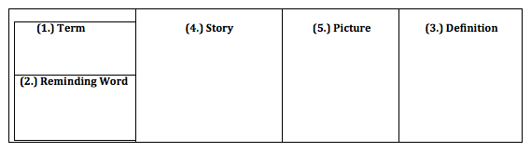

LINCS for Root Words on Flash Drive
fact
She is a fake
friend she made
me do her homework.
Made, do
fake

Slide 5
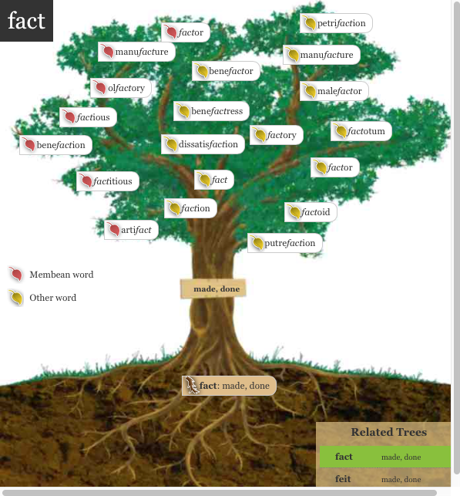

Slide 6
1. They decided to do away with the old machinery in the factory.
Do you recognize the root? (whiteboard)
Try out the meaning of the root in the sentence.
What do you think the word means?
Notes:
Have ½ the class do sentence number 1 and ½ the class do sentence number 2.

Slide 7
Add it to your personal dictionary
word | prefix | suffix | root | definition | sample
or
y
A place
where things
are made
factory
fact
Notes:
Students make an inference about the definition. Teacher/aide monitor and correct as needed. Have the students come up with the answers before answers appear. Have a brief conversation about how literal meaning “to lead away” doesn’t capture the essence (connotation) of the word.

Slide 8
The company manufactures a variety of paper goods.
Do you recognize the root? (whiteboard)
Try out the meaning of the root in the sentence.
What do you think the word means?

Slide 9
Add it to your personal dictionary
word | prefix | suffix | root | definition | sample
To make
something
fact
manufacture
ure
man
Notes:
Literally made by hand, but now changed to mean making or producing of anything

Slide 10
1. It gives me great satisfaction to eat chocolate.
Do you recognize the root? (whiteboard)
Try out the meaning of the root in the sentence.
What do you think the word means?

Slide 11
Add it to your personal dictionary
word | prefix | suffix | root | definition | sample
To make
happy
satisfaction
tion
fac
Notes:
Students make an inference about the definition. Teacher/aide monitor and correct as needed. Have the students come up with the answers before answers appear.

Slide 12
1. The artifact I found in my backyard is an
Indian arrowhead.
2. Experts will now study the artifacts and the skeletons to determine the burial site's age and how old the two were when they died, she said.
Do you recognize the root? (whiteboard)
Try out the meaning of the root in the sentence.
What do you think the word means?

Slide 13
Add it to your personal dictionary
word | prefix | suffix | root | definition | sample
Made by a
person
artifact
fact
Notes:
Students make an inference about the definition. Teacher/aide monitor and correct as needed. Have the students come up with the answers before answers appear. Prefix sub changes to sup when root starts with p- other example: suppress

Slide 14
1. Benjamin Whitworth, was a generous benefactor to the town; he built a new hospital.
Do you recognize the root? (whiteboard)
Try out the meaning of the root in the sentence.
What do you think the word means?

Slide 15
Add it to your personal dictionary
word | prefix | suffix | root | definition | sample
fact
To make good
benefactor
bene
Notes:
Students make an inference about the definition. Teacher/aide monitor and correct as needed. Have the students come up with the answers before answers appear. Prefix sub changes to sup when root starts with p- other example: suppress

Slide 16
1. Health is an important factor of happiness.
2. Scientists say many factors, such as global warming, bring about changes in weather.
Do you recognize the root? (whiteboard)
Try out the meaning of the root in the sentence.
What do you think the word means?

Slide 17
Add it to your personal dictionary
word | prefix | suffix | root | definition | sample
Something that makes a situation
what it is
factor
or
fact
Notes:
Students make an inference about the definition. Teacher/aide monitor and correct as needed. Have the students come up with the answers before answers appear. Prefix sub changes to sup when root starts with p- other example: suppress

Slide 18
1. To the great dissatisfaction of his parents, he resolved to return to Paris, and to earn his living there by giving lessons in art.
Do you recognize the root? (whiteboard)
Try out the meaning of the root in the sentence.
What do you think the word means?

Slide 19
Add it to your personal dictionary
word | prefix | suffix | root | definition | sample
To make
unhappy
dissatisfaction
dis
tion
fac
Notes:
Students make an inference about the definition. Teacher/aide monitor and correct as needed. Have the students come up with the answers before answers appear. Prefix sub changes to sup when root starts with p- other example: suppress

