Slide 1

Week 2
Theme Vocabulary
Step 1. Selecting the Words atmosphere inference literal

Slide 2
Step 2. Introduce the Word
THEME WORD ONE: atmosphere

Slide 3
atmosphere
relaxed atmosphere
warm atmosphere
friendly atmosphere
political atmosphere
frightening atmosphere
serious atmosphere
crazy atmosphere

Slide 4
Step 3. Rate Your Word Knowledge

Slide 5
Rate your Knowledge
1- I don’t know it.
2- I’ve heard it, but I don’t know the meaning.
3- I can use it in a sentence.
4- I can teach it to the class.

Slide 6
Step 4. Explanation and Example

Slide 7
atmosphere
The mood or feeling that exists in a place and affects the people who are there.
Example: The atmosphere in
General Zaroff’s mansion is frightening.

Slide 8
Step 5. Interact with the Word

Slide 9

The atmosphere is ___________.
relaxed
warm
friendly
political
frightening
serious
crazy

Slide 10
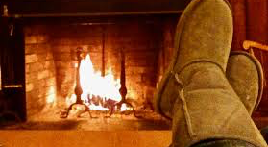
The atmosphere is ___________.
relaxed
warm
friendly
political
frightening
serious
crazy

Slide 11
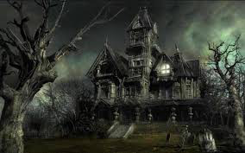
The atmosphere is ___________.
relaxed
warm
friendly
political
frightening
serious
crazy

Slide 12
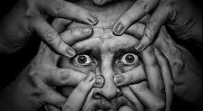
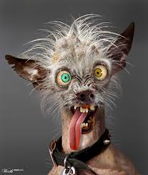
The atmosphere is ___________.
relaxed
warm
friendly
political
frightening
serious
crazy

Slide 13
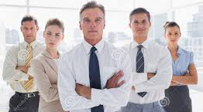
The atmosphere is ___________.
relaxed
warm
friendly
political
frightening
serious
crazy

Slide 14
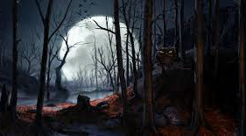
The atmosphere is ___________.
relaxed
warm
friendly
political
frightening
serious
crazy

Slide 15
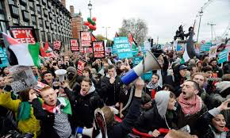
The atmosphere is ___________.
relaxed
warm
friendly
political
frightening
serious
crazy

Slide 16
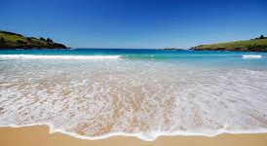
The atmosphere is ___________.
relaxed
warm
friendly
political
frightening
serious
crazy

Slide 17
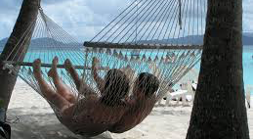
The atmosphere is ___________.
relaxed
warm
friendly
political
frightening
serious
crazy

Slide 18
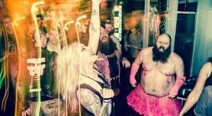
The atmosphere is ___________.
relaxed
warm
friendly
political
frightening
serious
crazy

Slide 19
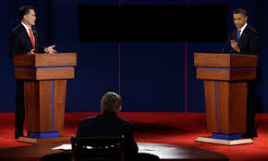
The atmosphere is ___________.
relaxed
warm
friendly
political
frightening
serious
crazy

Slide 20
Step 6. Review, Review, Review

Slide 21
Step 2. Introduce the Word
THEME WORD TWO: inference

Slide 22
inference
logical inference
possible inference
clear inference
make an inference
form an inference
Notes:
Have students say phrases out loud.

Slide 23
Step 3. Rate Your Word Knowledge

Slide 24
Rate your Knowledge
1- I don’t know it.
2- I’ve heard it, but I don’t know the meaning.
3- I can use it in a sentence.
4- I can teach it to the class.

Slide 25
Step 4. Explanation and Example

Slide 26
inference
Something that you think is true, based on information that you have, or evidence.
Example: Based on the fact that you make good grades I might make an inference that you are on time to your classes.
What other inferences could you make about someone who makes good grades?

Slide 27
Step 5. Interact with the Word

Slide 28
Activity
An inference is NOT just a guess.
To infer you need evidence.
Match the evidence below with the inference:
Practice putting responses in a complete sentence– you might be asked to share!
_________________ is evidence | that makes me infer_______________________.
Chocolate on the teacher’s face. A mousetrap in my basement. He gave that girl a rose. He didn’t answer when the teacher called on him. He finished the test quickly. | We have mice. He likes that girl. He didn’t know the answer. He studied. The teacher ate my brownie. He didn’t study.

Slide 29
Step 6. Review, Review, Review

Slide 30
Step 2. Introduce the Word
THEME WORD THREE: literal

Slide 31
literal
literal truth
literal meaning
literal description

Slide 32
Step 3. Rate Your Word Knowledge

Slide 33
Rate your Knowledge
1- I don’t know it.
2- I’ve heard it, but I don’t know the meaning.
3- I can use it in a sentence.
4- I can teach it to the class.

Slide 34
Step 4. Explanation and Example

Slide 35
Definition
The literal sense of a word or phrase is its most basic sense, with no hidden meanings. You can point to it.

Slide 36
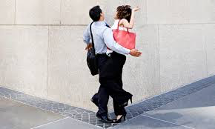
Example
We got there at the same time. We literally bumped into each other.

Slide 37
Step 5. Interact with the Word

Slide 38
Oral Activity
Literal or Inferential?
That is literal because __________________.
That is inferential because__________________.

Slide 39
Oral Activity
Literal or Inferential
That is literal because __________________.
That is inferential because ___________________.

Slide 40
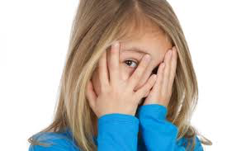
Literal or Inferential?
1. She is shy.
2. Her hands are covering her face.
That is literal because __________________.
That is inferential because ___________________.

Slide 41

Literal or Inferential
3. His cheeks are red.

Slide 42
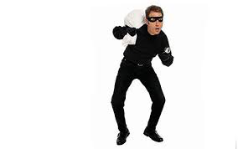
Literal or Inferential
He’s dressed in black and is carrying a bag.
He’s a robber.

Slide 43
Literal or Inferential
I can point to the answer.
The answer is in my head, but I use the text for evidence.

Slide 44
Which one is a literal question? Which one is inferential?
What is in the wagon?
Literal- I can point to the answer.
2. Do you think he enjoys riding in a tiny
wagon?
Inferential– we would have to make an educated guess
3. What color is the wagon?
Literal we can point to it.
4. Is this meme funny? Why or why not?
Inferential- we would have to give an opinion with evidence

Slide 45
Step 6. Review, Review, Review

Slide 46
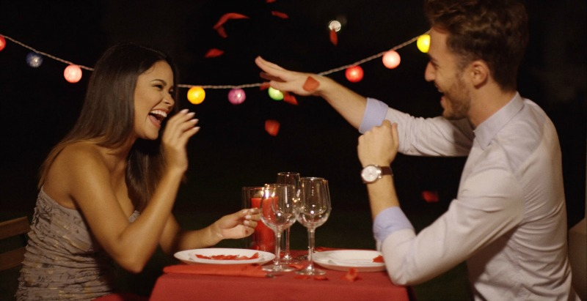
Please write one literal question and one inferential question about the atmosphere in this picture.

